Slide 1
Credit Lending Project
Remmy | Sumeet | Satya | Preshit | Sahil

Slide 2
Why this Project?
Learn to apply the Data Science concepts to a real world business problem
Checkpoint for the Actual Learning achieved
Get a sense of what Data Science involves practically
Completion of the DSP program

Slide 3
Resources Available
Problem Statement
Dataset
Data Dictionary
Google Colab platform
Team to solve the problem at hand

Slide 4
Problem Statement & Objective
Problem at Hand:
Build a data model to predict the probability of default, and choose a cut-off based on what we feel is suitable. Alternatively we could also use a modelling technique which gives binary output.
Objective:
Based on the data that is available during loan application, build a model to predict default in the future. This will help the company in deciding whether or not to pass the loan.

Slide 5
Method
Understood the Problem & Objective
Understood the Data to develop some business sense
This is a Classification Problem at hand
Learnt how to use the Google Colab platform for modelling
Practically performed the Coding exercise on the Google Colab platform

Slide 6
Creating the Dataframe

Slide 7
Read the Data and Created a copy of the Data frame
Exploratory Data Analysis → We found (Obs:855969, Var:72)
Data was biased towards Class 0

Slide 8
Exploratory Data Analysis

Slide 9
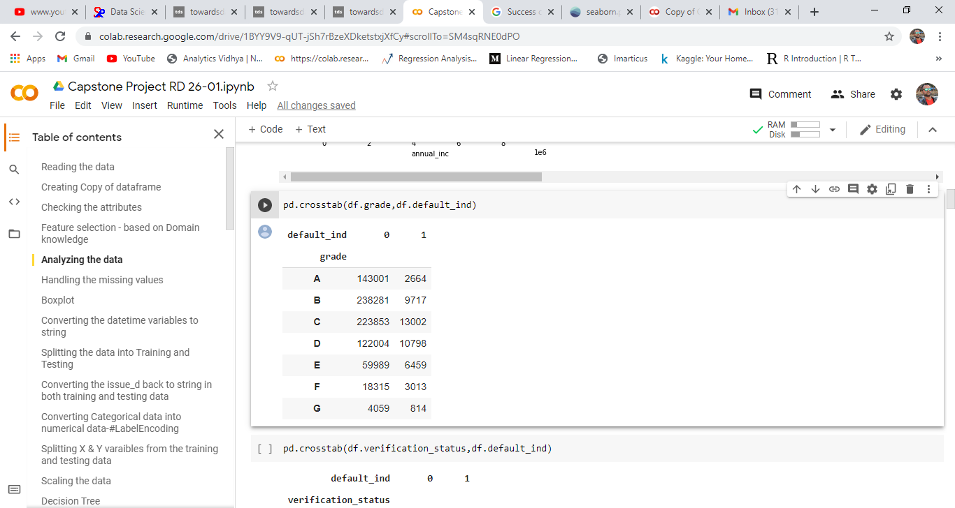
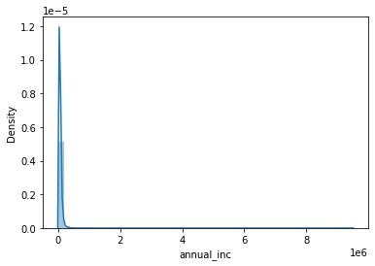
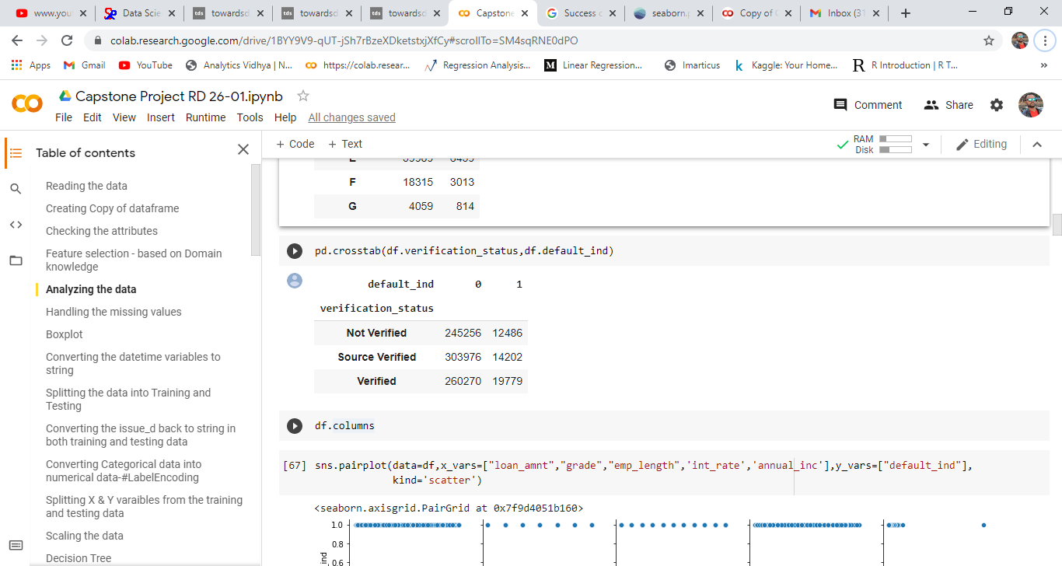
The variable annual_inc was heavily right skewed
Most of the defaulters belonged to Grade C and Grade D loans
CrossTable verified Data biased on Class 0

Slide 10
Pre-Processing the data

Slide 11
Feature Selection basis Domain knowledge
'member_id','addr_state','zip_code','collection_recovery_fee','desc','mths_since_last_major_derog', 'next_pymnt_d’, 'policy_code’, 'recoveries’, 'title' - Dropped using drop() function

Slide 12
Handling the Missing Values
The annual_inc_joint','dti_joint','verification_status_joint are all related to the joint loan category
annual_inc_joint and dti_joint would have to be imputed with 0 for data related to individual loans
'verification_status_joint' has uniqie values as 'Not Verified', 'Source Verified', 'Verified' so blank values should be imputed with 'Not Verified'
Imputing certain categorical variable with mode value may lead to biasing of the dataset as emp_title's mode value is Teacher , while we already have income variable to be used. hence dropping that variable
Also Dropping the missing values in the variable -'Emp_length' as the mode value is 10+ years, the missing values in this variable is <15% , hence dropping those observations.

Slide 13
Handling the Outliers
When we performed Outlier Detection using Boxplots →
(dti, revol_util, tot_coll_amt, tot_cur_bal, total_rev_hi_lim) had outliers
Used Capping Approach and imputed these values to Q3 + (1.5 * IQR) (boxplot upper whisker lines)

Slide 14
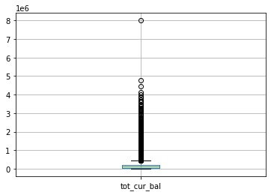
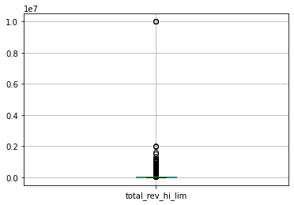
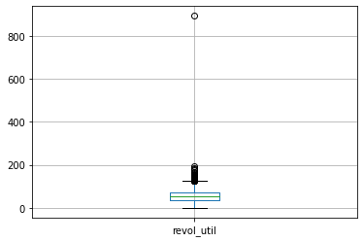
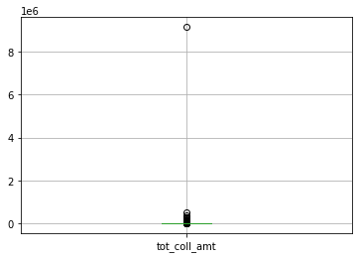
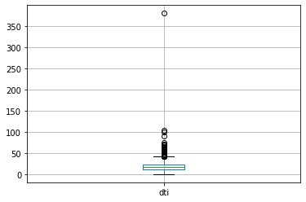
Handling the Outliers

Slide 15
Creating training and testing data

Slide 16
Requirement – Split the data on the basis of loan issue date ‘issue_d’
Training Data – all observations from June 1, 2007 - May 31, 2015
Training data comprised 570,873 obsns and 60 variables
Testing Data – all observations after June 1, 2015 – Dec 31, 2015
Testing data comprised 242,035 obsns and 60 variables

Slide 17
Label Encoding

Slide 18
Label Encoding is done as sklearn supports numerical data only
Used LabelEncoder() to convert categorical variables to numerical variables
Variable names include →
['term', 'grade', 'sub_grade', 'emp_length', 'home_ownership', 'verification_status', 'issue_d', 'purpose', 'earliest_cr_line', 'initial_list_status', 'last_pymnt_d', 'last_credit_pull_d’]

Slide 19
Scaling and Splitting data

Slide 20
Created X_train, X_test, Y_train, and Y_test variables
Used StandardScaler() for scaling the data
StandardScaler() is a standardization technique which mitigates the affect of outliers in the data and helps in Normalization of data

Slide 21
Model building

Slide 22
Base Models
Logistic Regression → useful for Binary classification
Decision Trees → useful for Feature importance
Results we got:

Slide 23
Techniques

Slide 24
Techniques 1 and 2
Upsampling
Used resample function to perform Upsampling
Used Smote (Synthetic Minority Oversampling Technique)
Comparing outputs from resample() and Smote → resample() resulted in a higher accuracy score for Logistic Regression Modeling

Slide 25
Technique 3
Boruta – Used for Feature Selection
Boruta helped us identify 36 variables of importance to be included in the model
Boruta also helped us identify 23 variables to be dropped
Technique 4
PCA (Principal Component Analysis) – Used for Dimensionality Reduction, but we did not use this as our Model Accuracy reduced using PCA

Slide 26
Output of Techniques Applied

Slide 27
Model Tuning

Slide 28
Pruned the Decision Tree on Min_samples_leaf, criterion and max_depth
Tuned the Logistic Regression by Adjusting the Threshold at 0.60
Tuned Random Forest (Bagging technique) on n_estimators, min_leaves_sample and max_depth
Boosting used to convert weak learners to strong learners
XGB – Xtreme Gradient Boosting | SGD – Stochastic Gradient Descent

Slide 29
Evaluation of Ensemble Model
Ensemble Model (Voting Classifier) used to combine Logistic Regression and (Tuned) RandomForest
Evaluation of Classifier using Confusion Matrix, Accuracy Score, and Classification Report
Our Model Accuracy is High → Recall Value / Majority Class is large
Class 0 – 241748 | Class 1 – 287

Slide 30
Business Sense
Reducing the Errors in Class 0 → We are not rejecting loan applications with an assumption they are defaulters.
Loans are a source of Revenues for the bank
Risk of not being able to detect the defaulters → 20%
Thus, 80% of the time the model is predicted to be able to detect the defaulters correctly
Accuracy of 0.99968 → Out of every 100 obsns, our model is expected to be able to predict 99 obsns accurately

Slide 31
THANK YOU

